Slide 1

Designing An Implementing a Data Warehouse
Franco Bueno Mattera
CS 689

Slide 2
Crime occurrences in Boston
Purpose:
Design and implement a data warehouse that will contain most relevant crime occurrences through different Boston neighborhoods.
It should help business assess level of risk for a particular time, season, area, etc.
Example:
If the business role is transportation (taxi, uber, bus) there could be times of days when customers would not use the service due to the risk of being the victim of an offense
Notes:
From a business perspective, it could be important to know how crime works in this city and how it affects business. For example, property crimes need to be taken into consideration when dealing with the transport and storage of valuable books. If the business role is transportation (taxi, uber, bus) there could be times of days when customers would not use the service due to the risk of being the victim of an offense. Other crimes, especially violent ones will be added since they should also impact business.

Slide 3
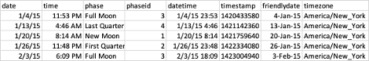
Data Sources
Kaggle’s Boston Crime Data
Data from 2015 to 2020
17 columns and 525576 rows.
Boston’s Weather Data
Data from 2012-2017
37 columns with 45254 rows
Lunar Cycles

Slide 4
Business Questions
Which districts are the most prone to crime and at what time of day?
How does crime vary between seasons, quarters, months weeks, or days?
Is there a relationship between weather and crime? Are hot days more likely?
Are hot days more likely to cause violent crime to rise?
Are hidden weather features that may also be related to crime?
What is the trend of certain crimes, is it increasing, decreasing, or remaining?
Are there any other hidden patterns that may be influencing crime in the city?
For example, lunar cycle

Slide 5
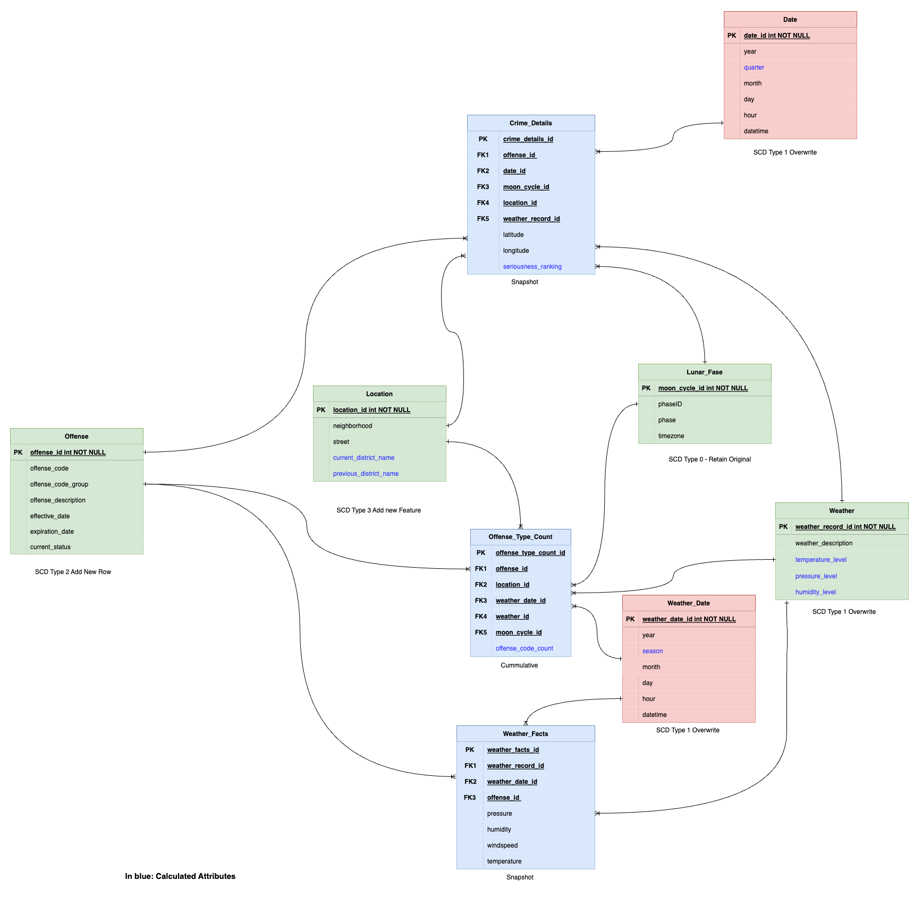
Warehouse Design

Slide 6
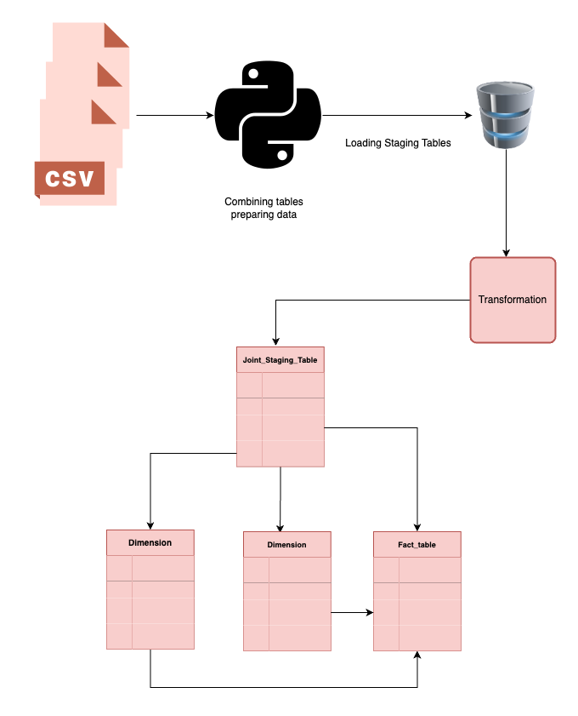
ETL Process

Slide 7
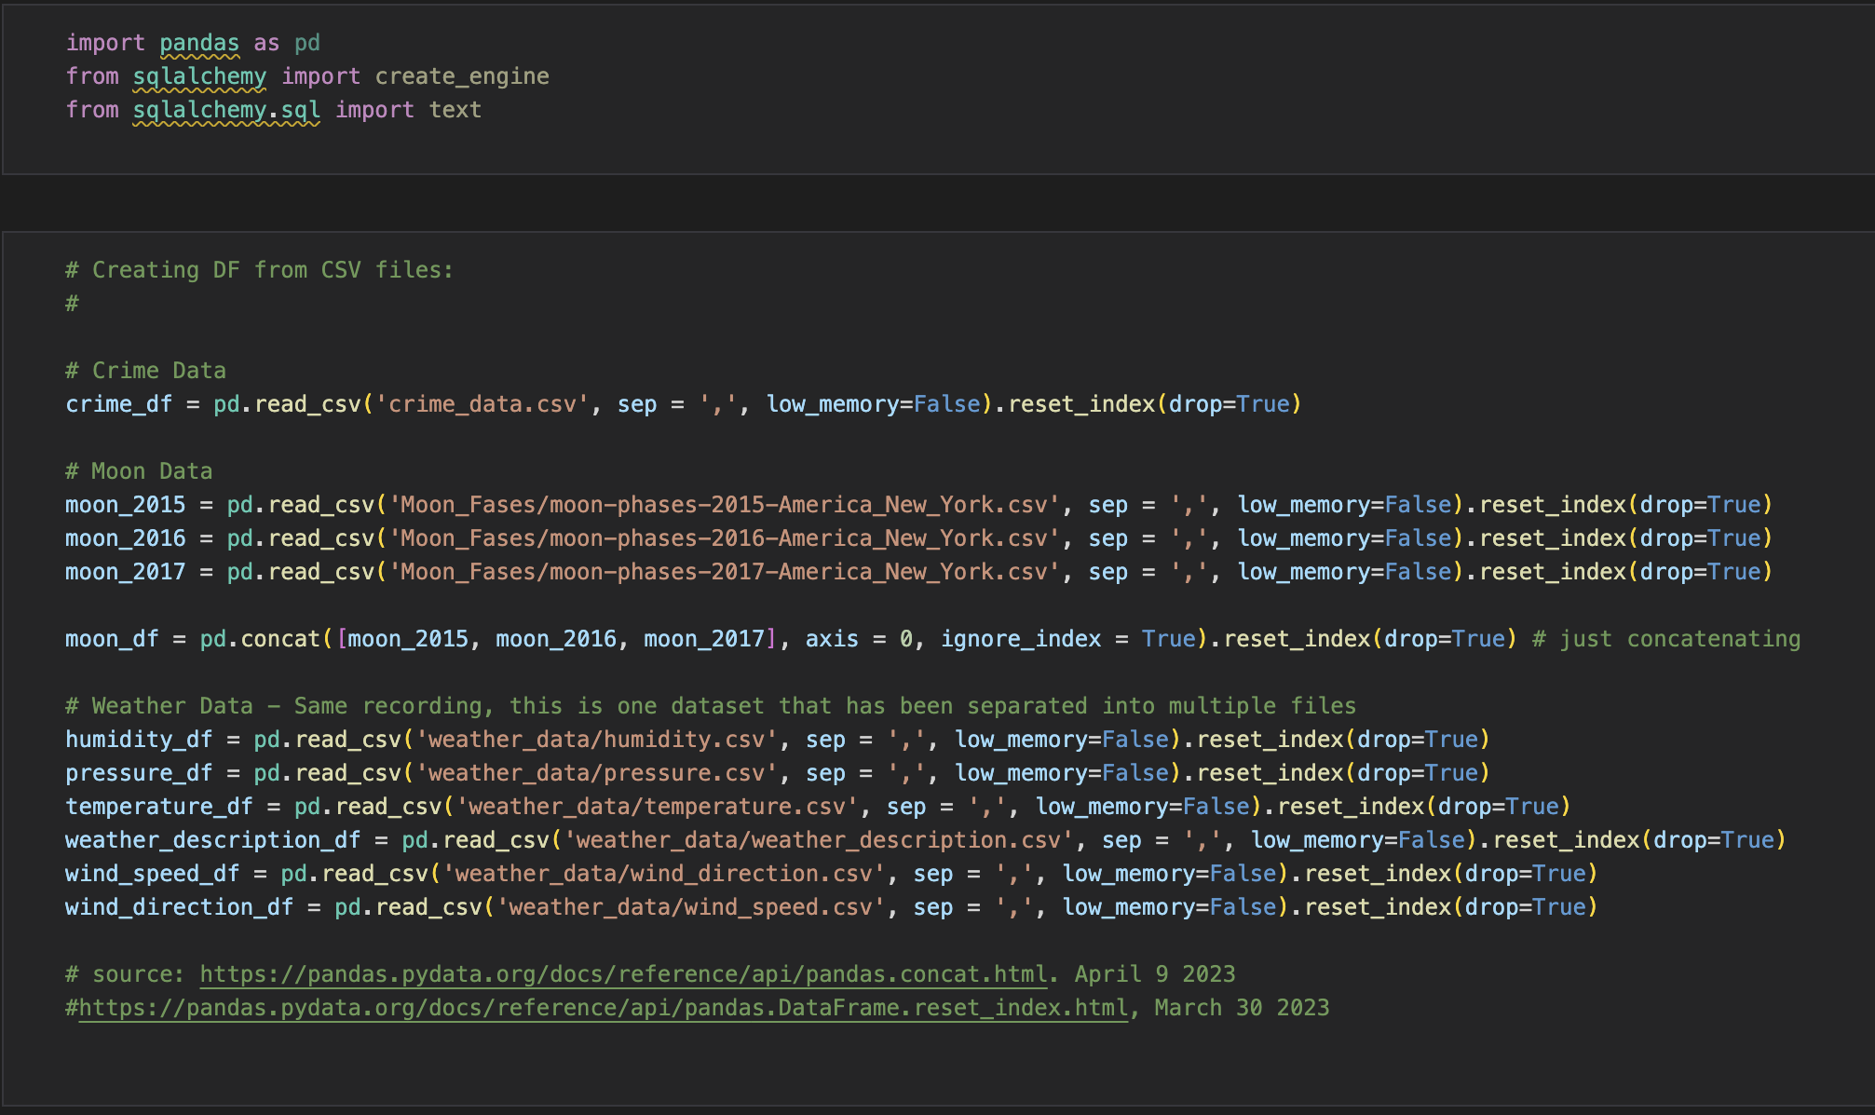
ETL Process
Preparing the data
Notes:
Combining moon data together

Slide 8
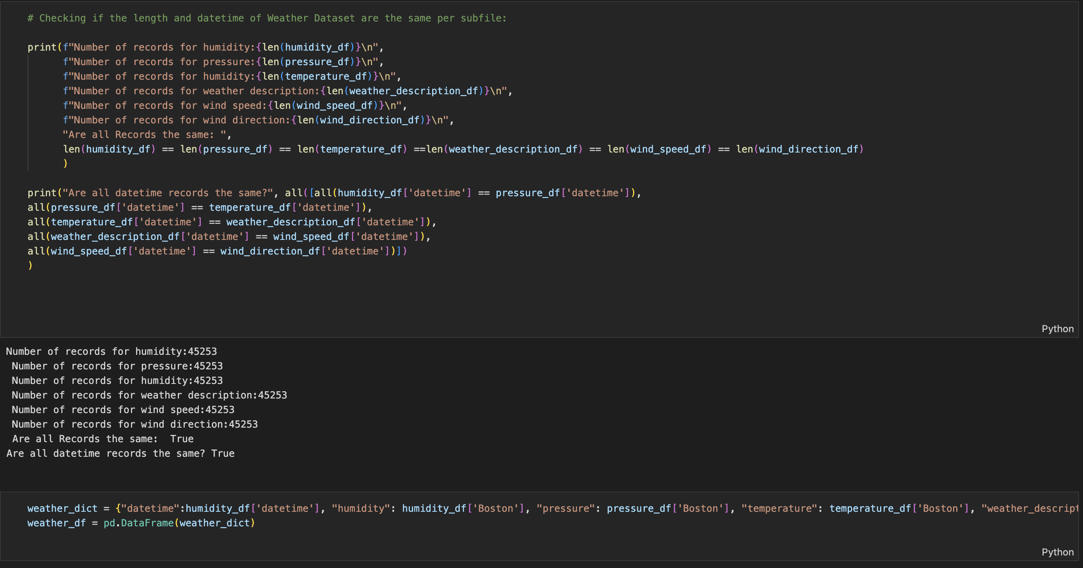
ETL Process
Preparing the data

Slide 9
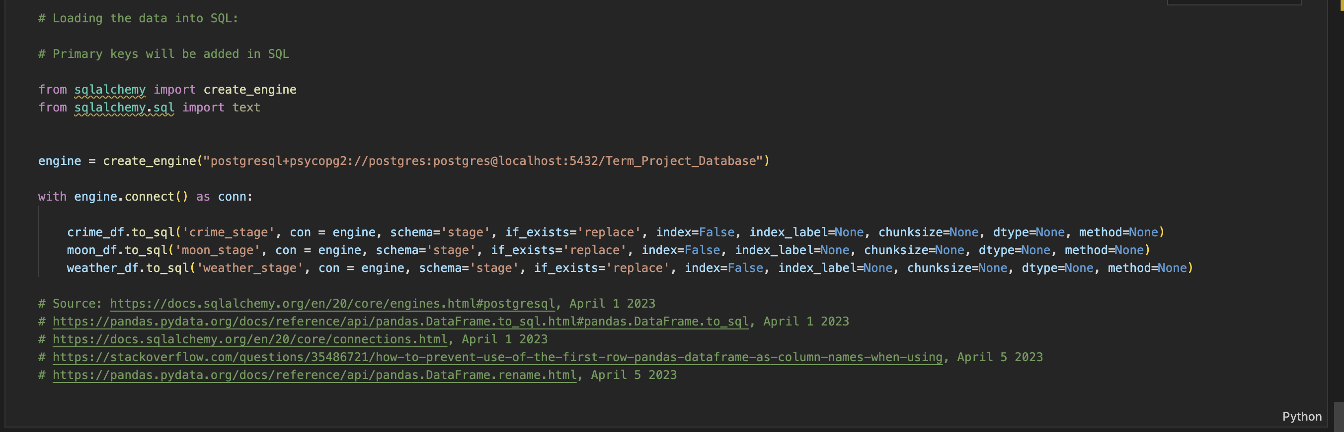
ETL Process
Creating stagging tables and migrating to DB

Slide 10
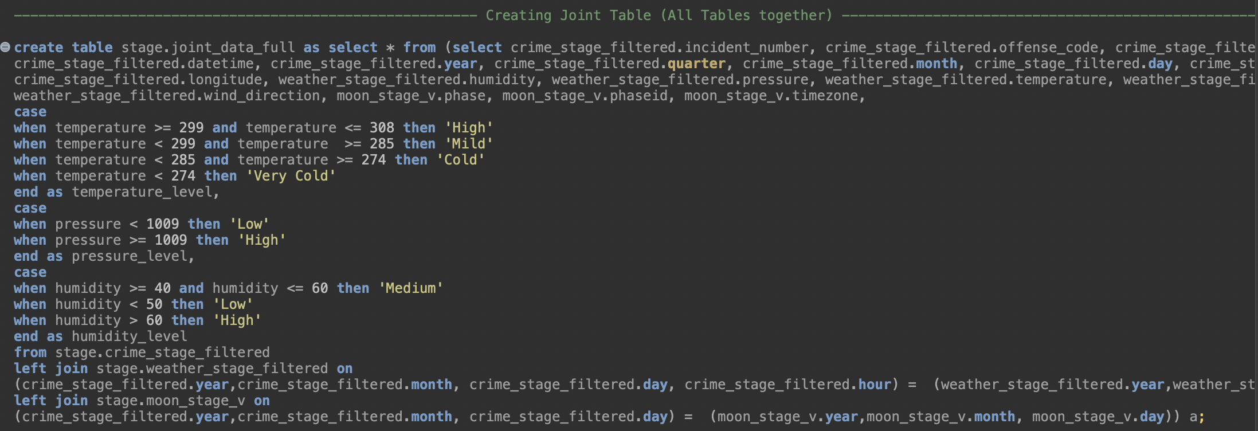
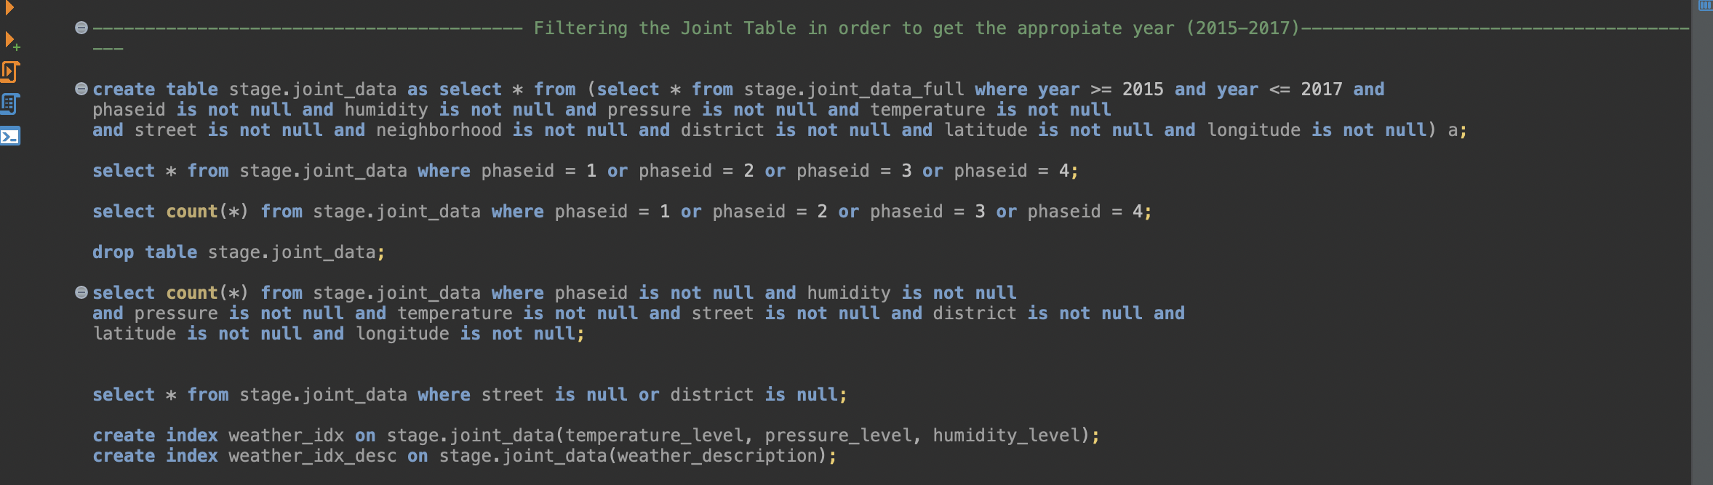
ETL Process
Transformations on the stagging table.
Creating final Joint Staging table
Filtering to only include overlapping years

Slide 11
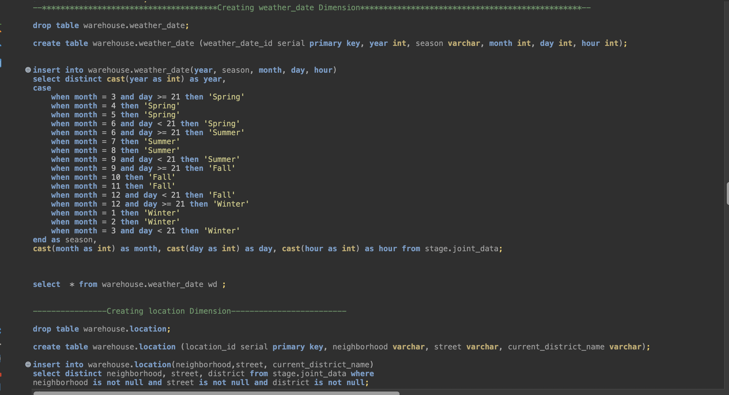
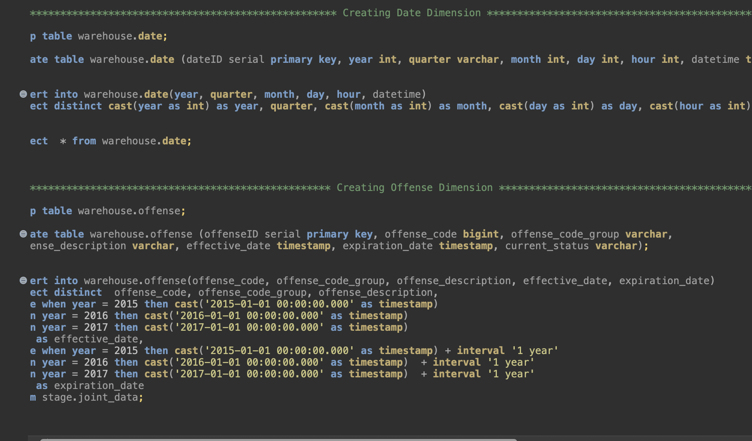
ETL Process
Creating Dimensions
Multiple transformations before inserting into dimensions
Avoiding Duplicates

Slide 12
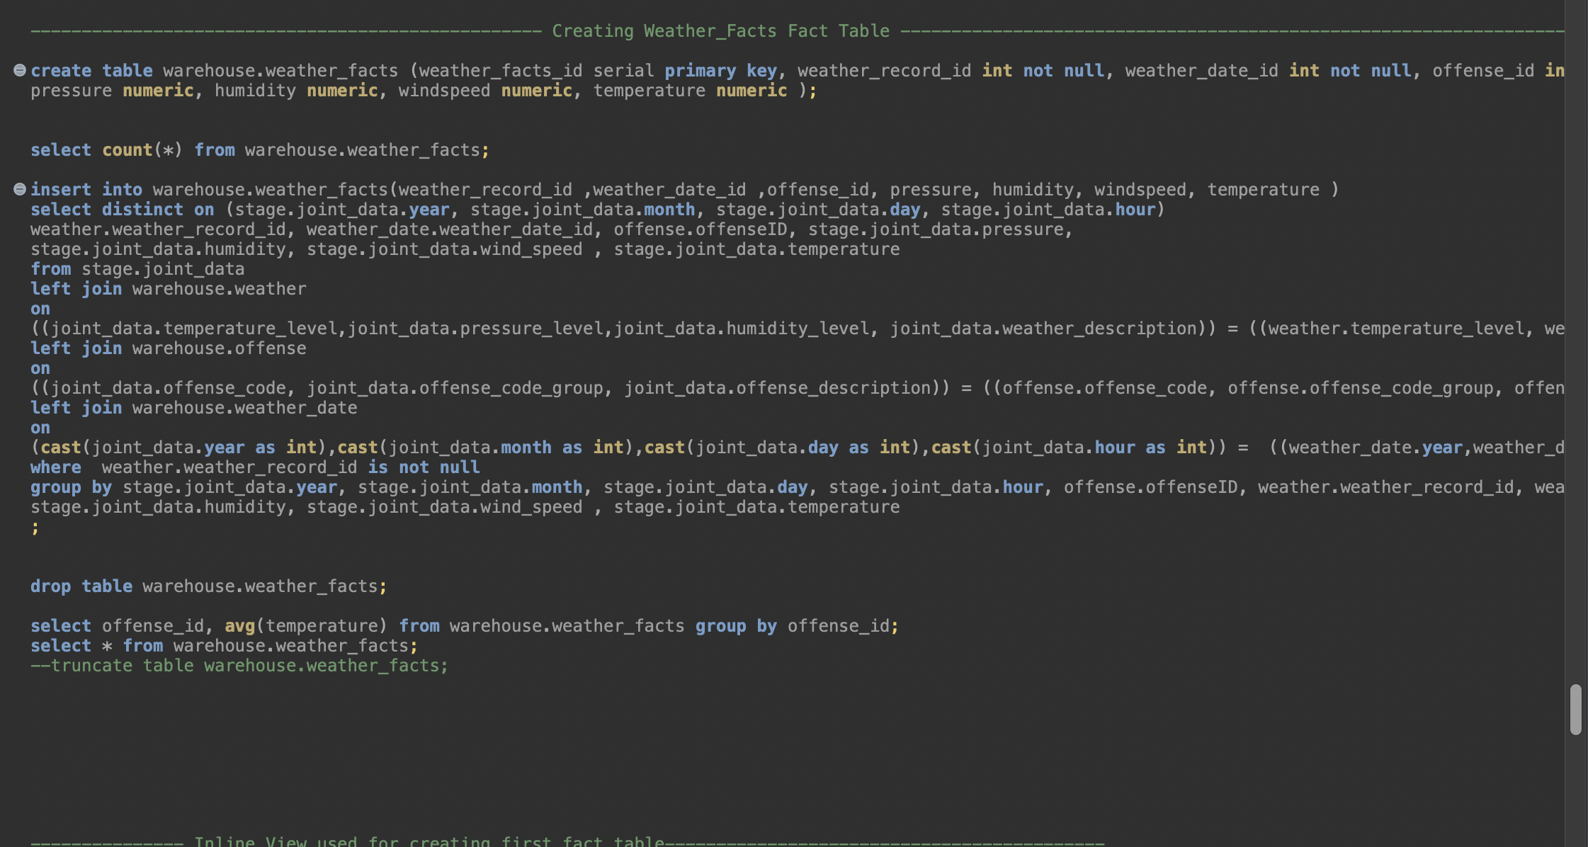
ETL Process
Creating Fact Tables
Gathered content from joint stage table and joined with dimension.
Took care of potential nulls violating constraint

Slide 13
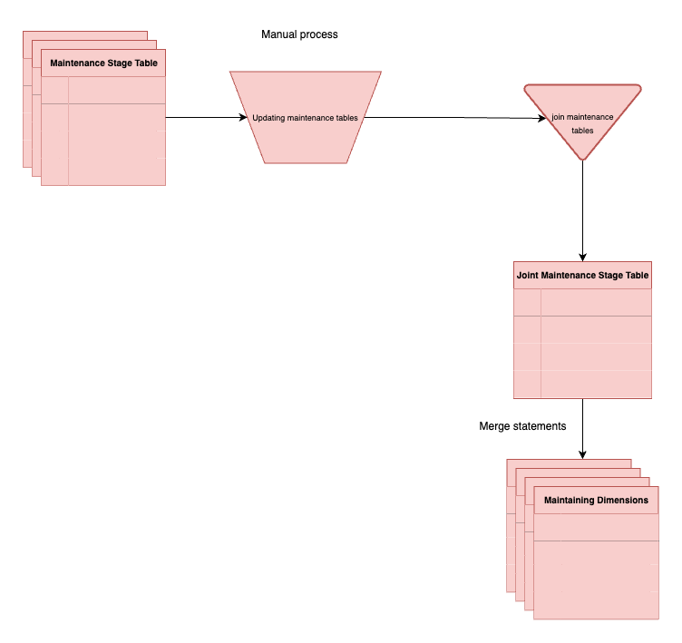
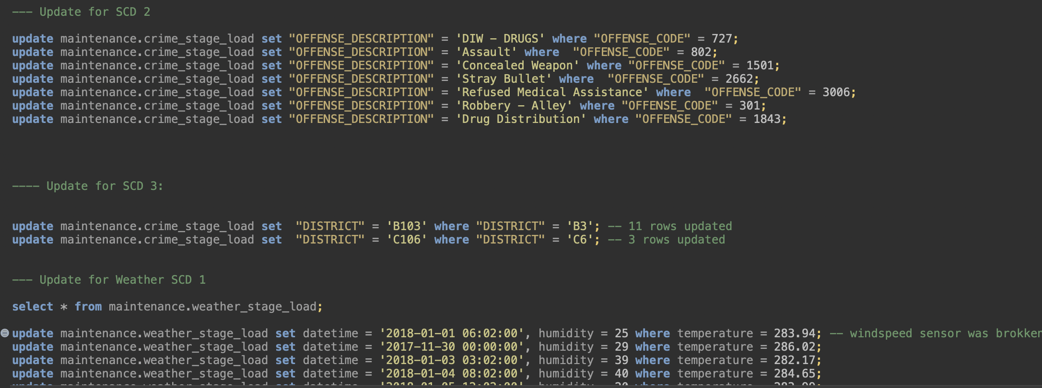
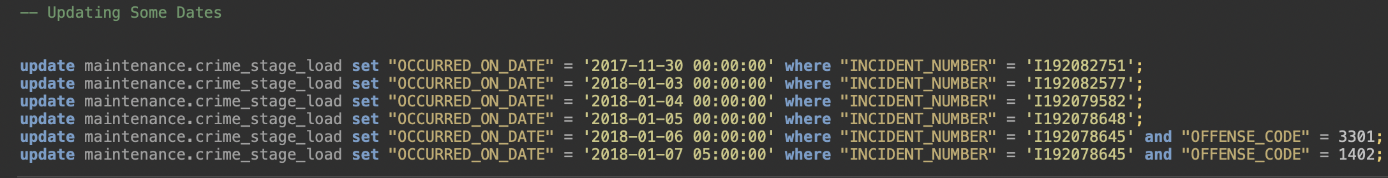
SCD Maintenance

Slide 14
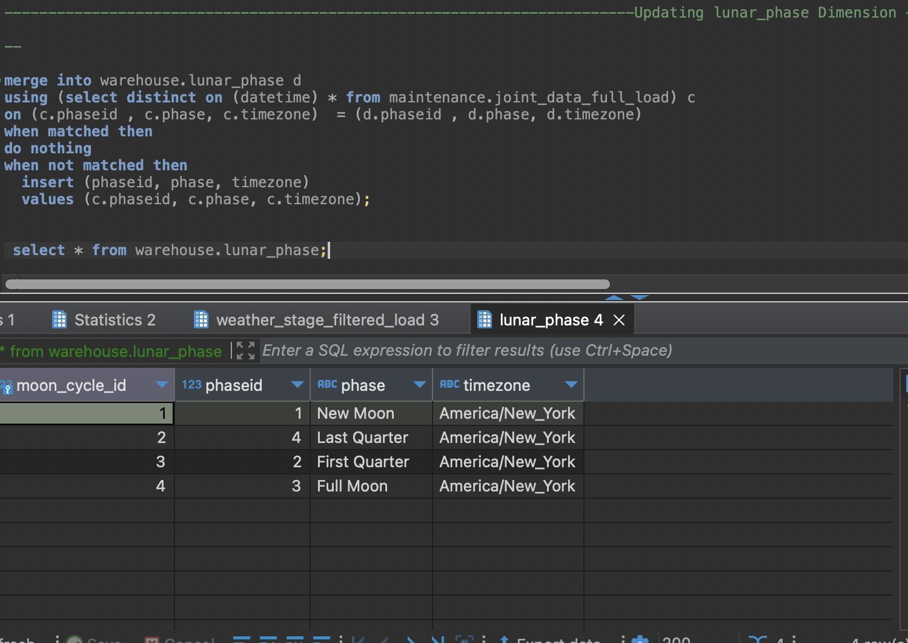
SCD Maintenance
SCD 0
Content is immutable

Slide 15
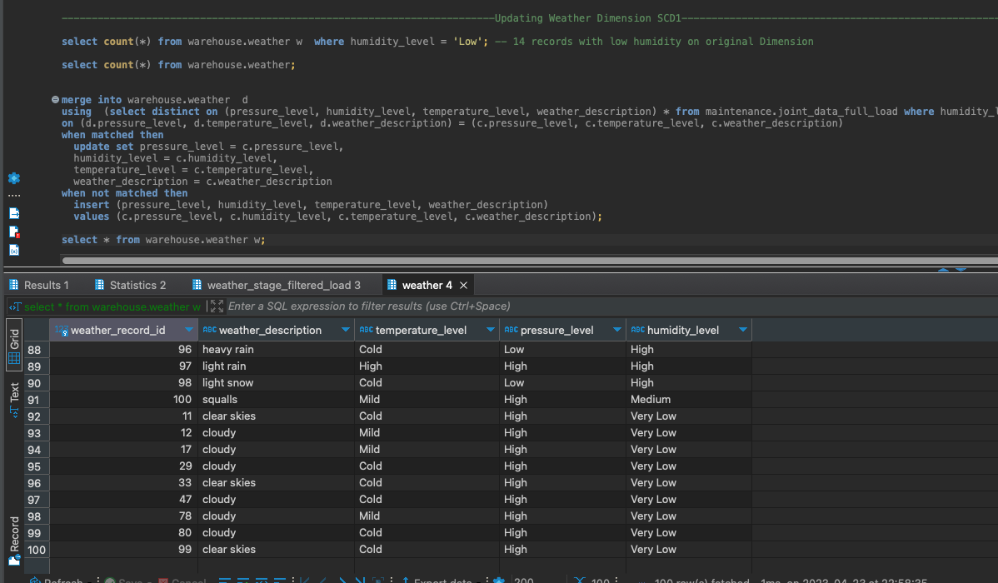
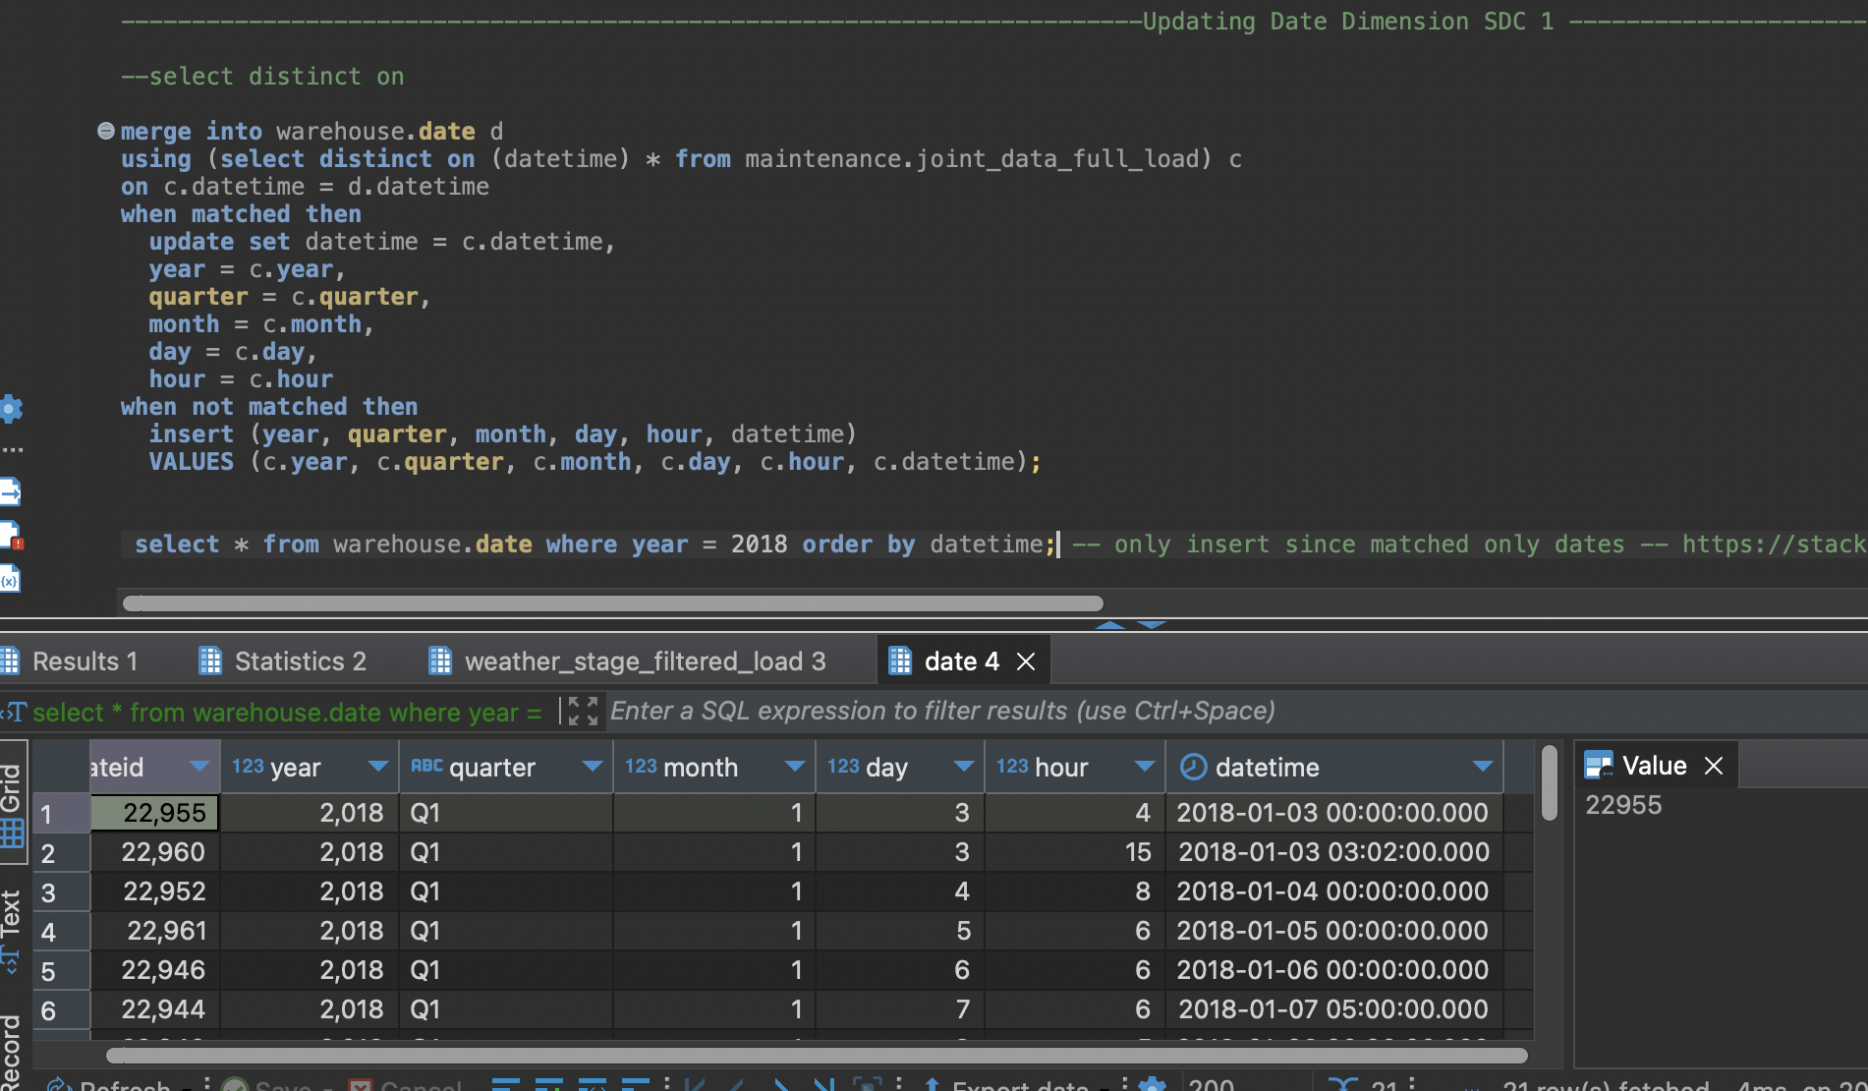
SCD Maintenance
SCD1
Added 2018 – “Date” Dim
New category for Humidity: ”Very_low” – “Weather” Dim

Slide 16
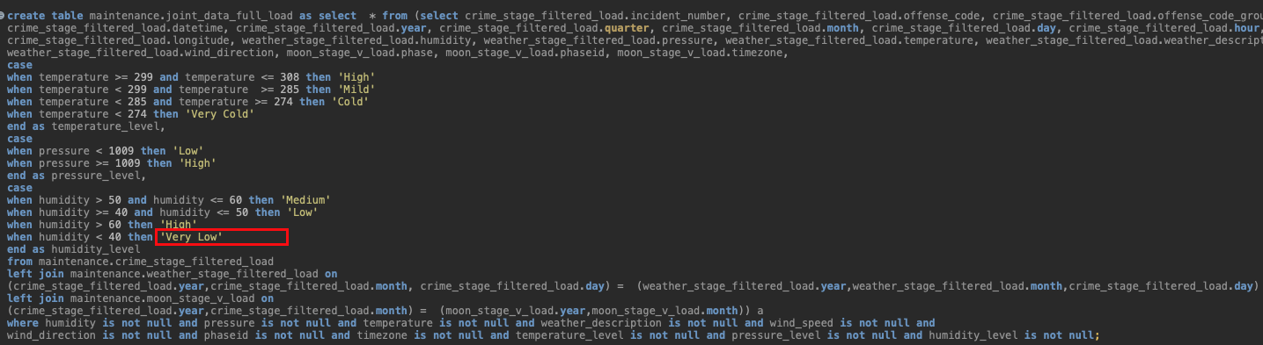
SCD Maintenance
SCD1
Added 2018 – “Date” Dim
New category for Humidity: ”Very_low” – “Weather” Dim

Slide 17
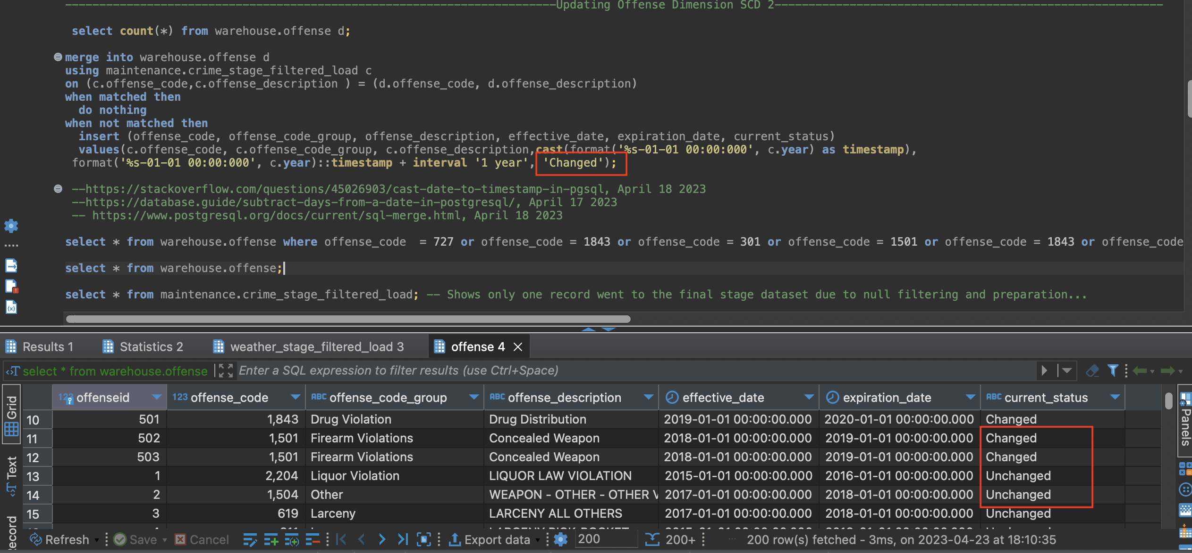
SCD Maintenance
SCD2
“Offense” Dimension
Status of offense description changed for particular offense code

Slide 18
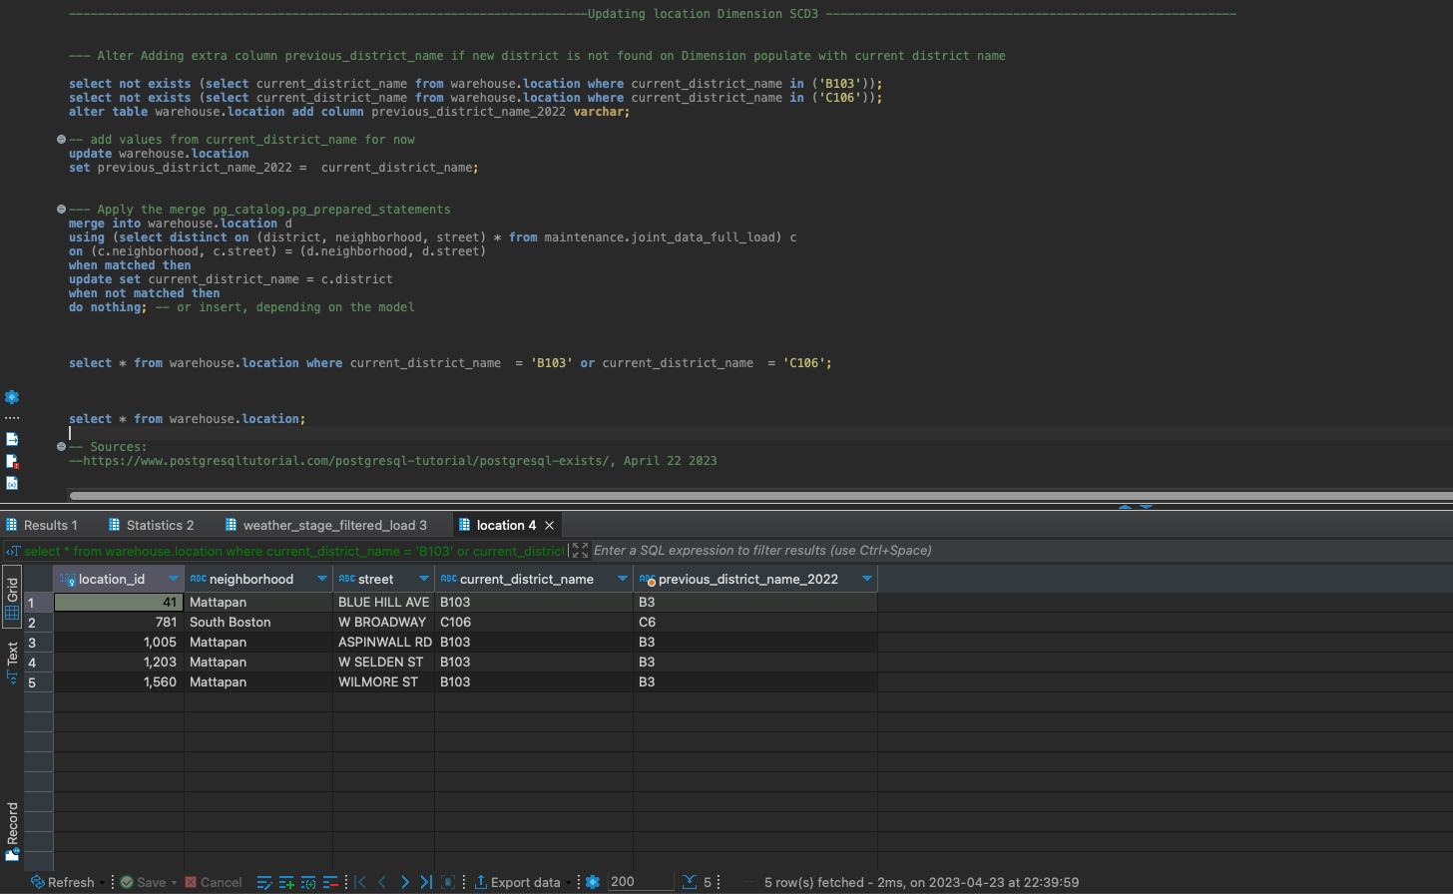
SCD Maintenance
SCD3
“Location” Dimension
Two district names were updated on 2023

Slide 19
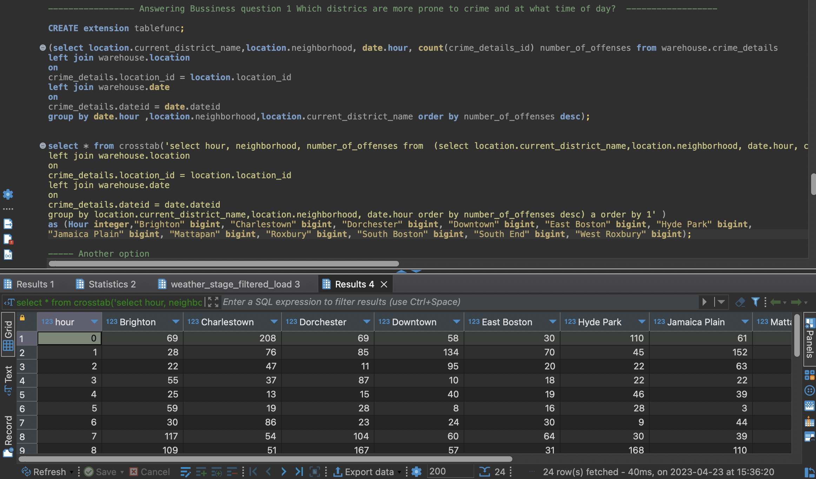
Business questions
1. Which districts are the most prone to crime and at what time of day?

Slide 20
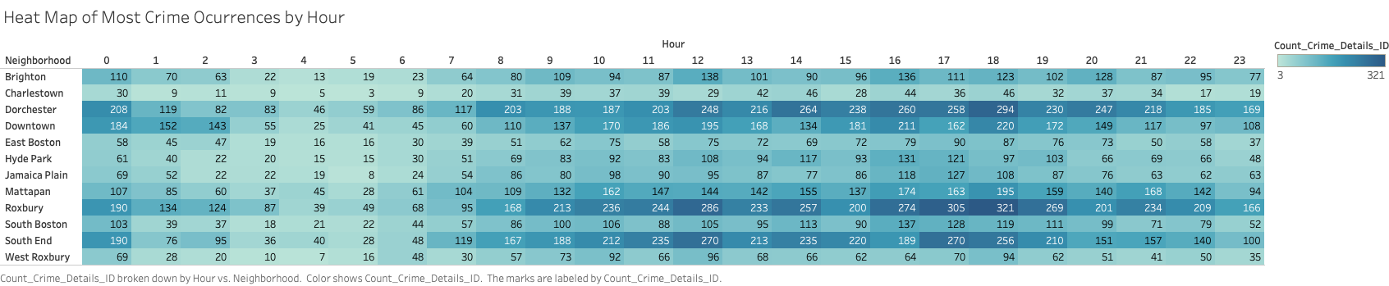
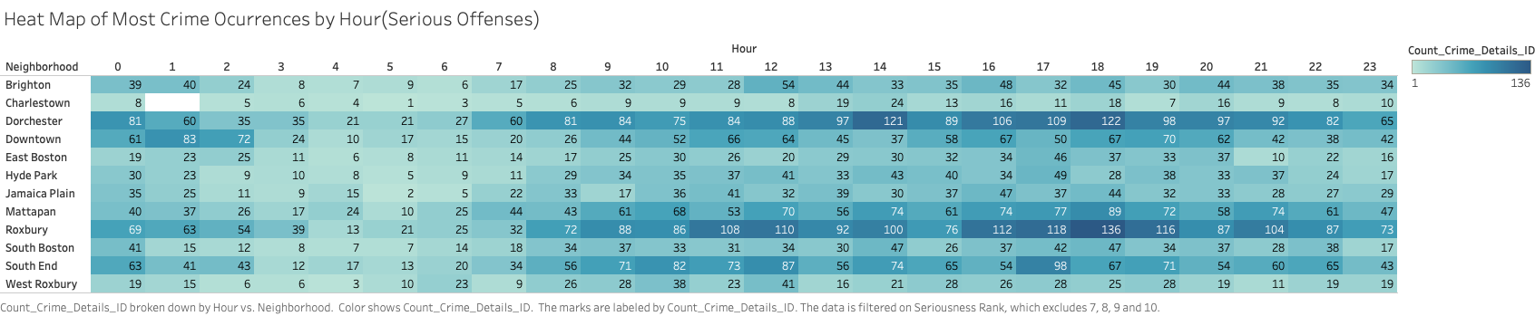
Business questions
1. Which districts are the most prone to crime and at what time of day?

Slide 21
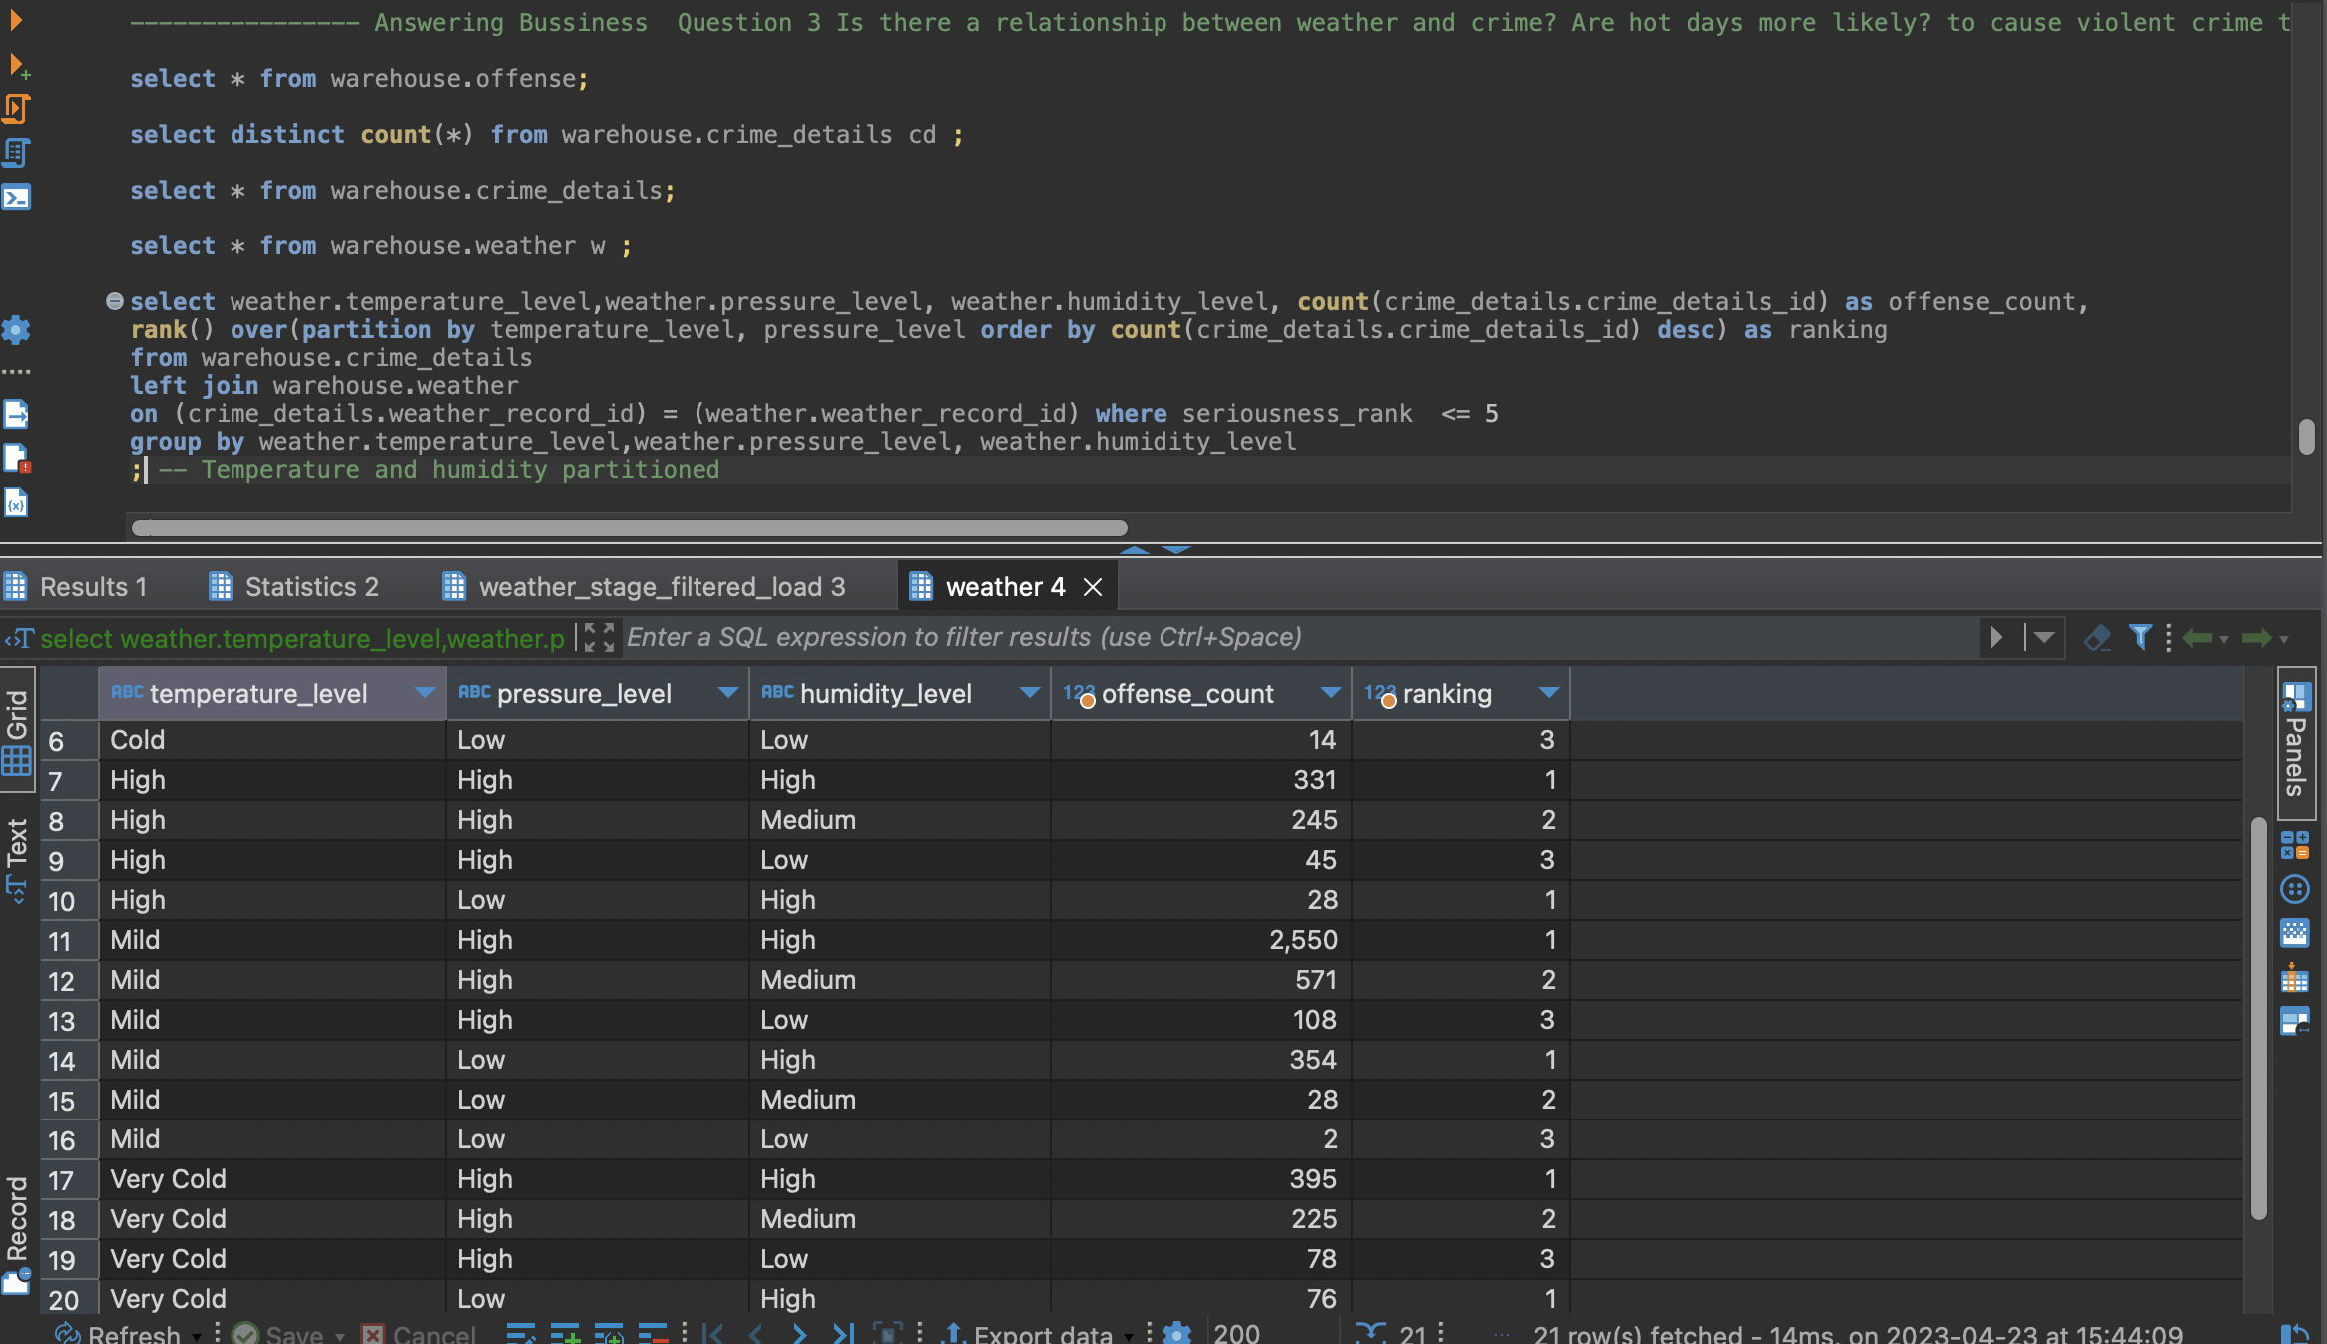
Business questions
3. Is there a relationship between weather and crime?

Slide 22
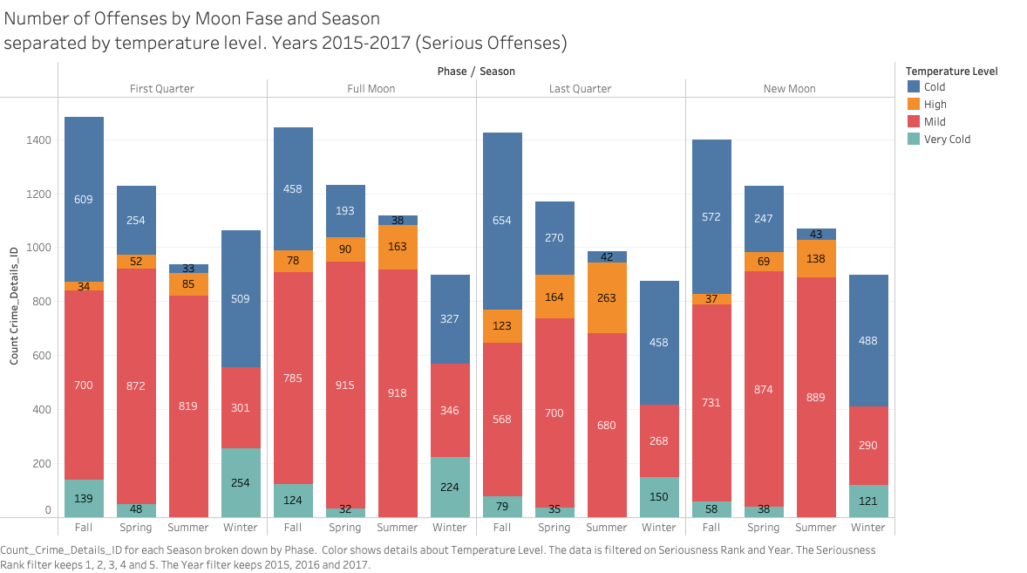
Business questions
3. Is there a relationship between weather and crime?

Slide 23
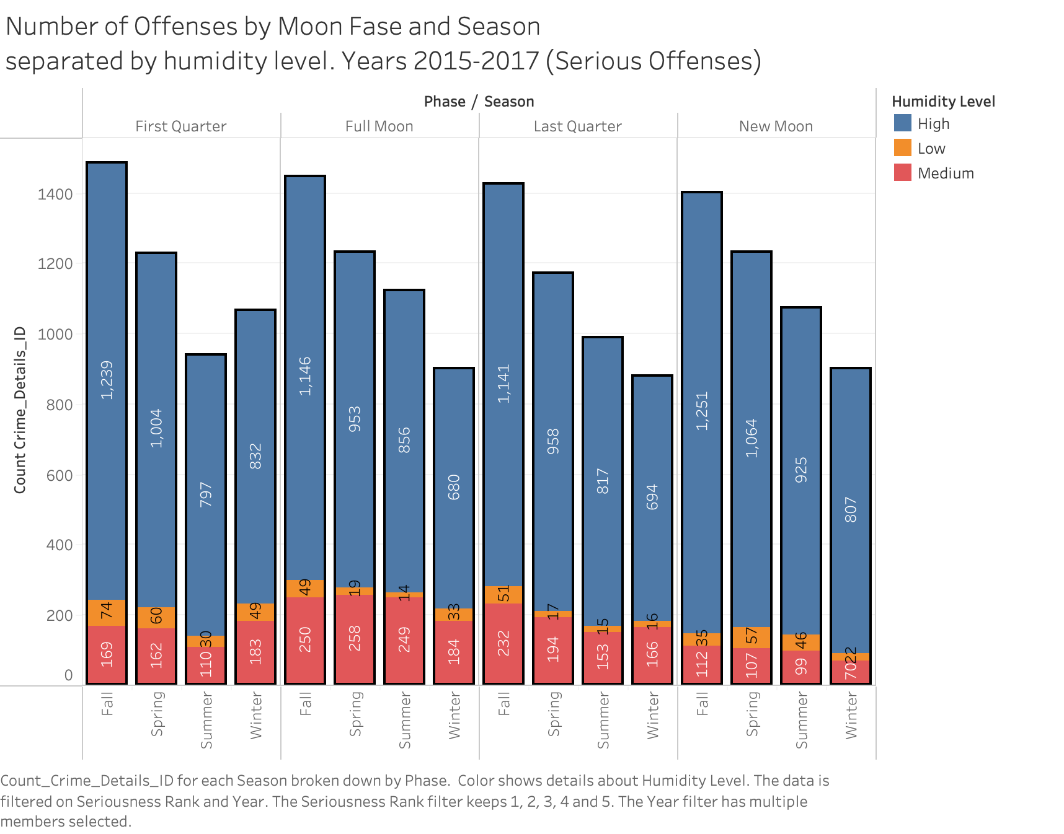
Business questions
3. Is there a relationship between weather and crime?

Slide 24
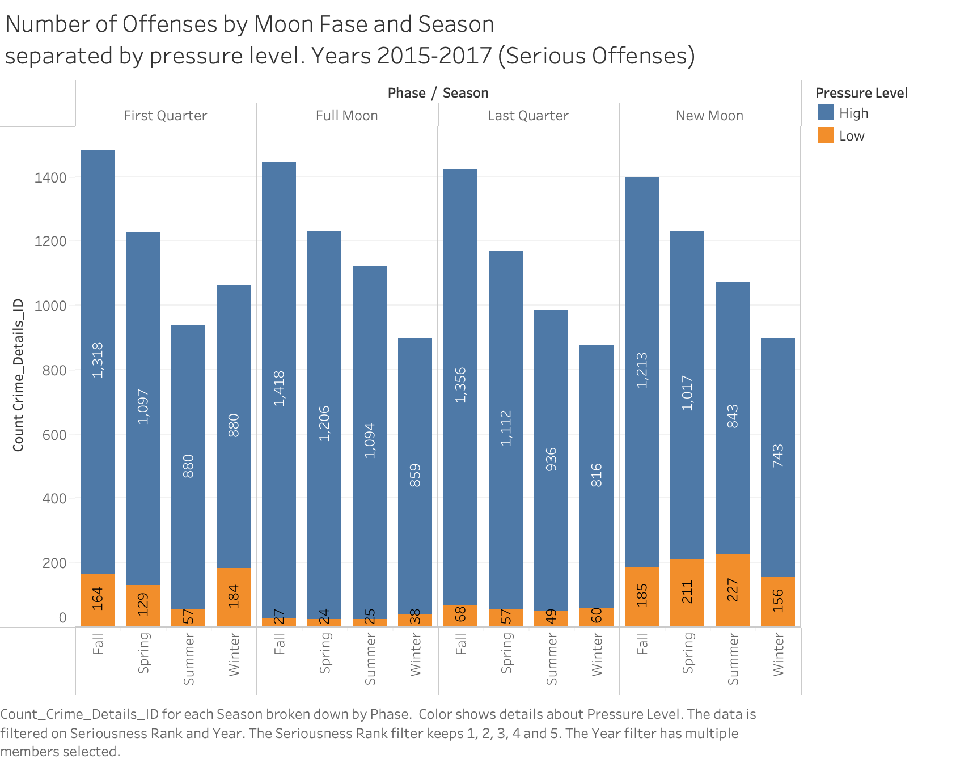
Business questions
3. Is there a relationship between weather and crime?

Slide 25
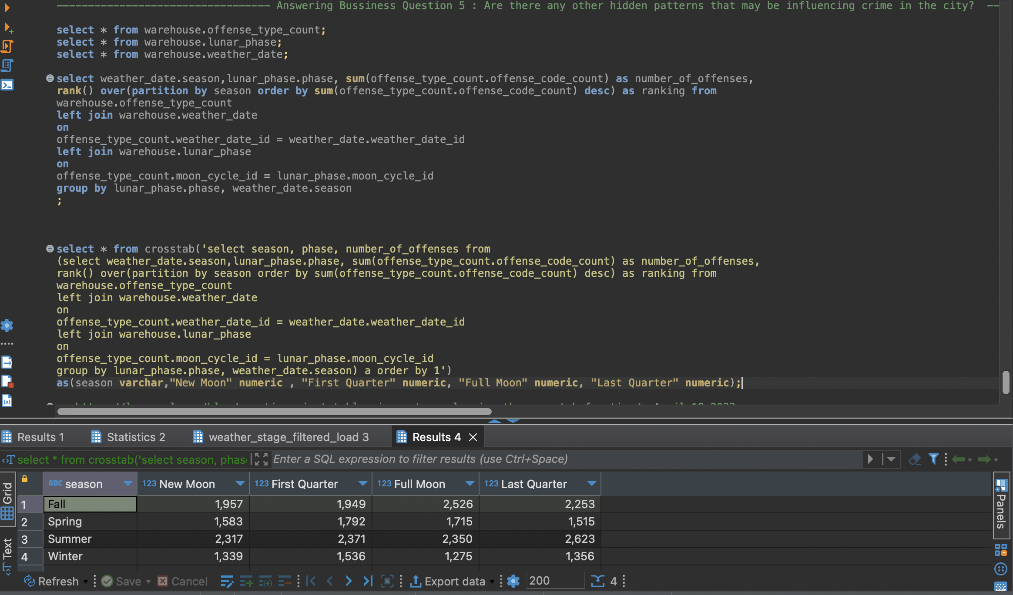
Business questions
Are there any other hidden patterns that may be influencing crime in the city?

Slide 26
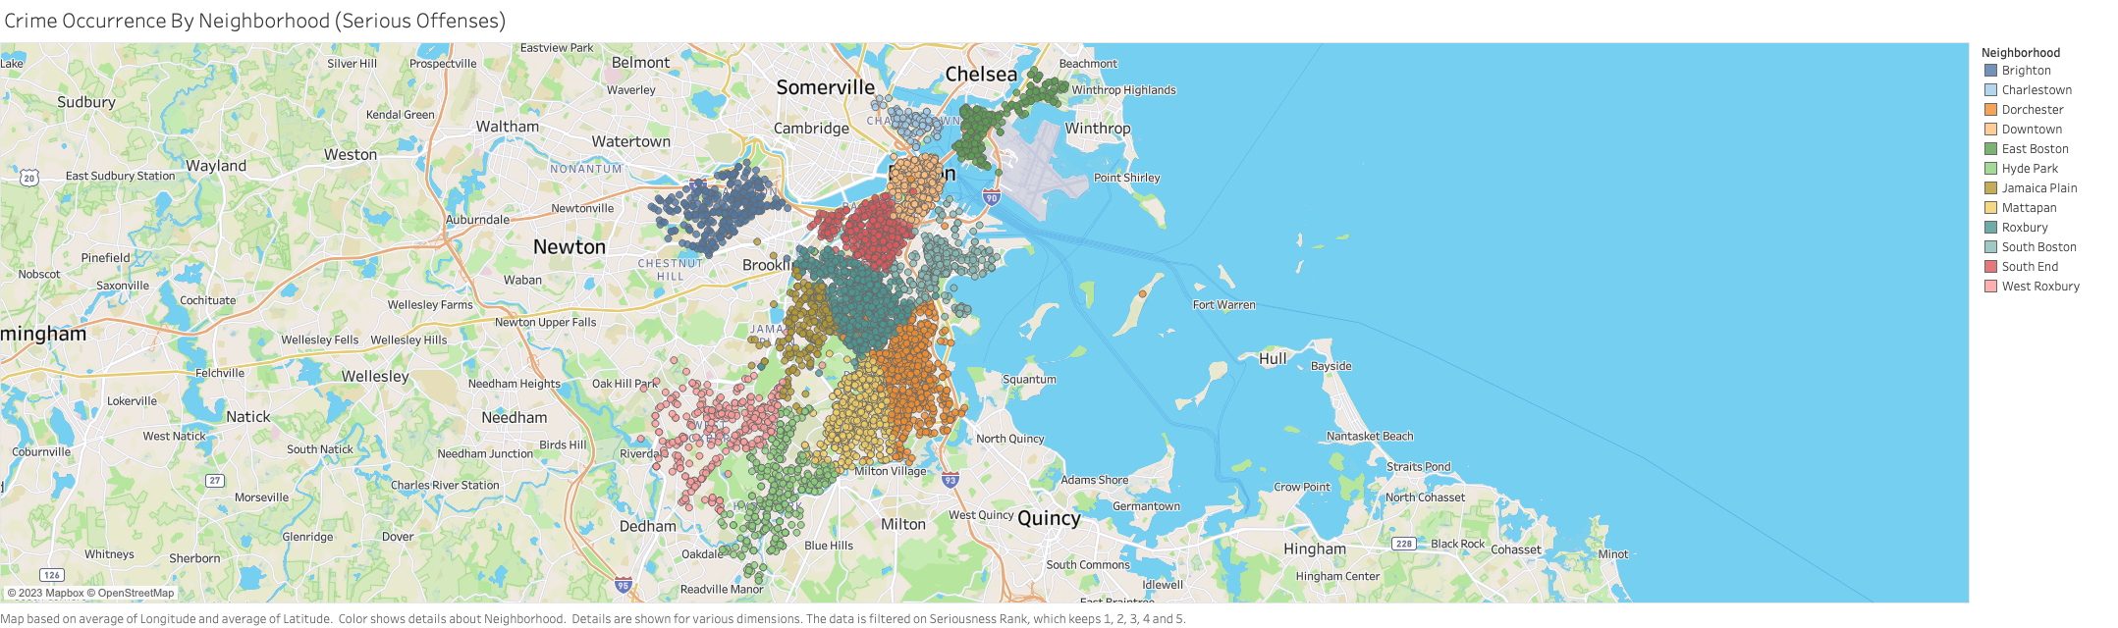
Additional Insights

Slide 27
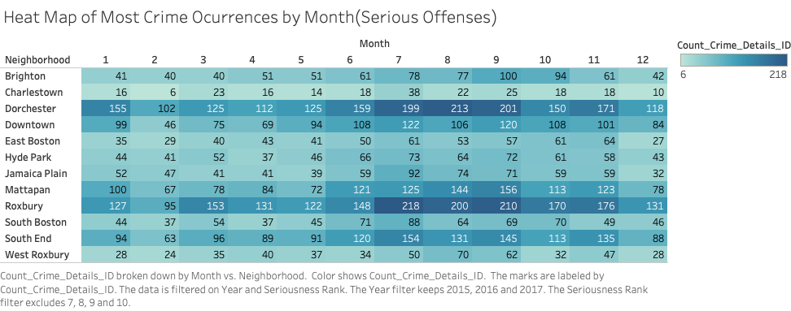
Additional Insights

Slide 28
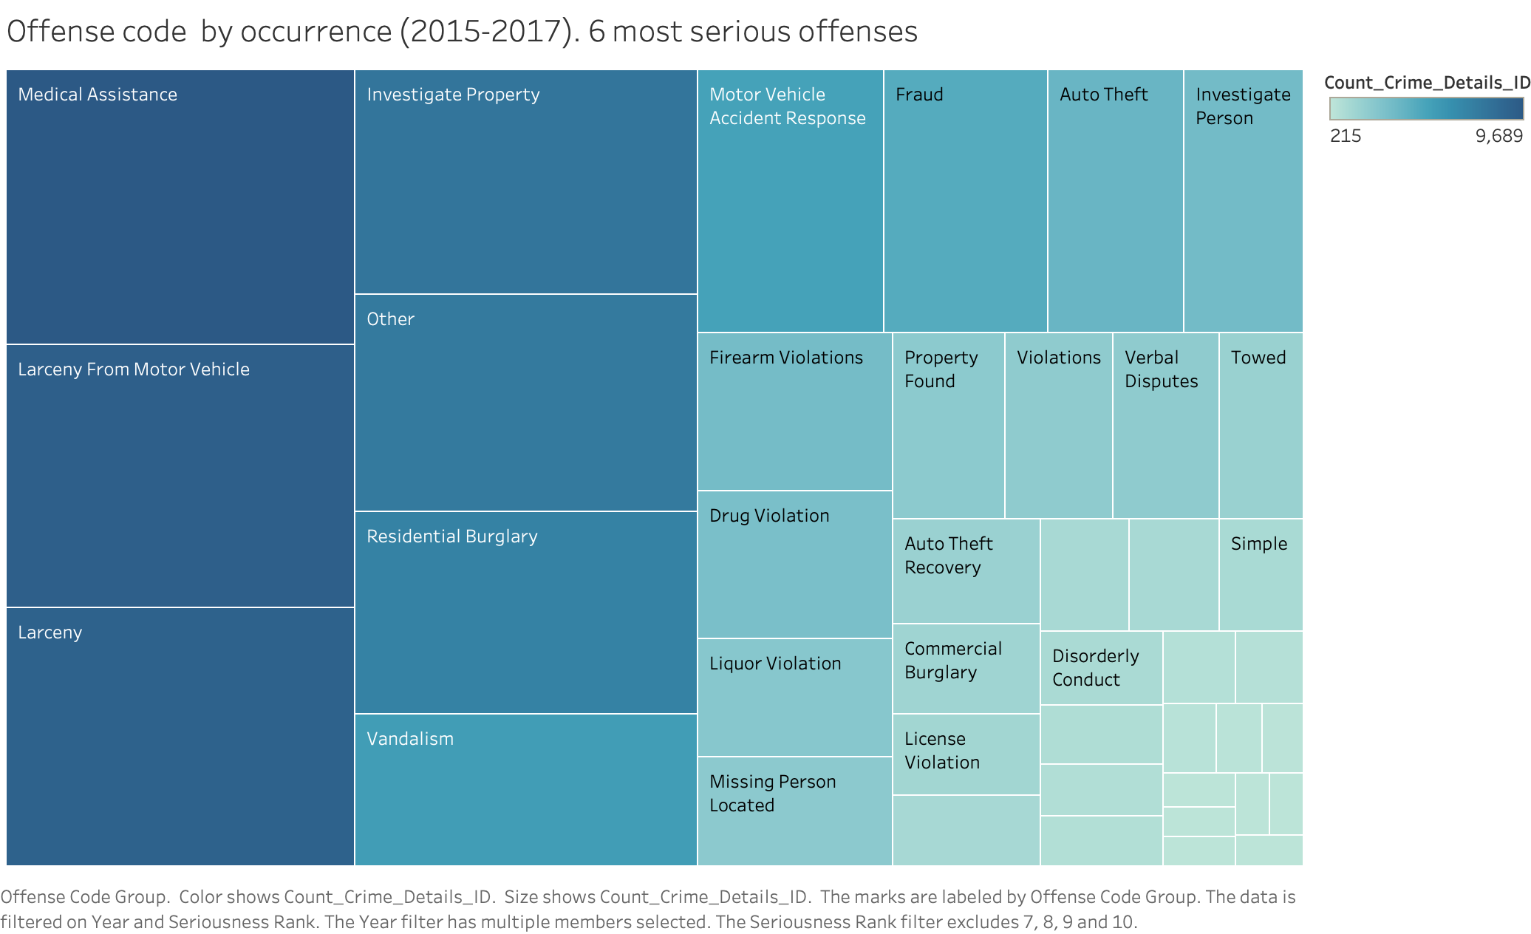
Additional Insights
Notes:
Descriptions are not more useful than offense code. And they could be a bit shocking.

Slide 29
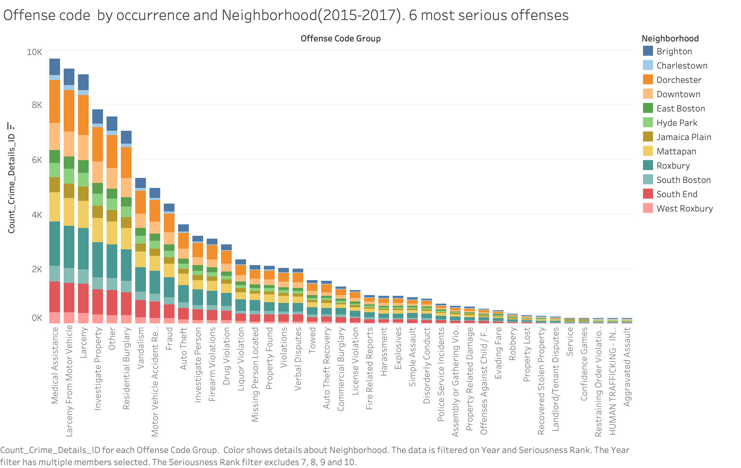
Additional Insights

Slide 30
Thank you!

